Slide 1
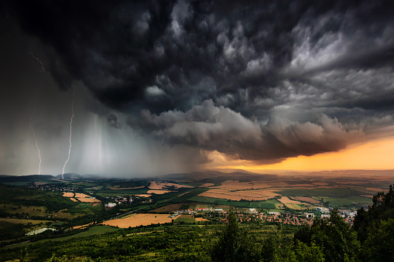
A Weather Clock
A different type of UI for the display of the weather conditions outside

Slide 2
What am I going to talk about?
As part of the Ignite Internet of Things group I like to build electronic devices for displaying data in interesting ways
This device takes weather data which can usually be displayed on a phone and displays it on a clock face.
I’m going to concentrate on the technical aspects of this build rather than the steampunk build of the clock details as it is not finished.
I have been asked for Innovation week to tell people how I did all this so interested people could try building IoT examples with their own ideas.

Slide 3
What am I not going to talk about?
I plan to skirt round the issues with building the actual clock body and concentrate on the coding and electronic parts of this build.
If anyone wants to read more details of what issues and unexpected complexity and problems I ran into during the build you will be able to look at my blog at http://stronans.com/blogSHK/ (though this entry is not published yet, but will be before the end of June).
Those interested in the code, both for the Arduino and the Raspberry Pi it is currently posted at https://github.com/ksimes/ as a public repo but be aware that it is still a work in progress.

Slide 4

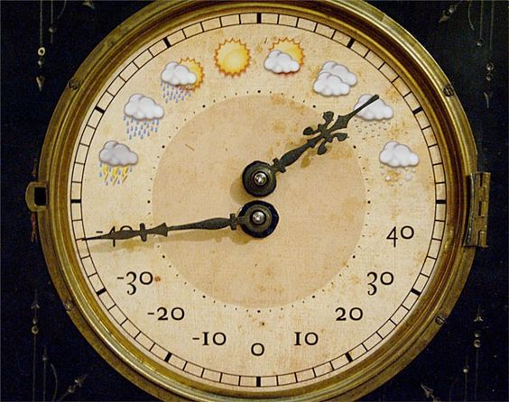
First Decisions
There were a few decisions that had to be taken into account.
I had seen on the internet this idea several years ago for a clock face showing the weather state and the temperature. This project was initially a direct steal of that
I was sure that I could put more information in as well as produce a more colourful and interesting face and clock
This originally is from the MAKE website: https://makezine.com/2010/01/11/the-weather-clock/ from Canada by Sean
I wanted it to be a proper clock for a mantlepiece

Slide 5
Application and UI Design
Get some Weather data
Translate it into a common format
Pick out a set of data that can be displayed on dials
Make sure it can be updated hourly
And in 24, 36 and 72 hours in the future
So I needed buttons to select the future dates
And LEDs to show when time frame I was looking at
I wanted some sound as well so you knew when it updated

Slide 6
So, who’s go the data?
AccuWeather was one option
Based in US
Has an API which can be called
Data was very friendly but may not be accurate for area
Has a free tier, but has very few calls per day
City based
There is always the MetOffice?
Based in UK
Has an API which can be called
Has a free tier, not many calls per day, but for £8 per month it triples that!
Latitude and longitude based, so closer to my location
My final choice was MetOffice data

Slide 7
Coding design decisions
Decided to use the old workhorse of Java
With Lombok
And of course Spring Framework, Spring Boot starter and WebFlux
And a favourite library to use with the Raspberry Pi – Pi4J version 2
Caused problems in itself
I also wanted to use Arduino Nanos’ to control the servos which would turn the hands to show the weather
Servos would lead to a limitation for the UI
As well as a increase on the number of Nanos
So the code for the Nanos would have to be written in C++

Slide 8
Needless to say, Encapsulation
Encapsulated the getDataFromProvider part and made sure that it was configurable in the application file so I could put more data providers in later.
Did the same for the writing of the messages to the Arduinos
Even kept the processing of the weather data nicely in one place

Slide 9
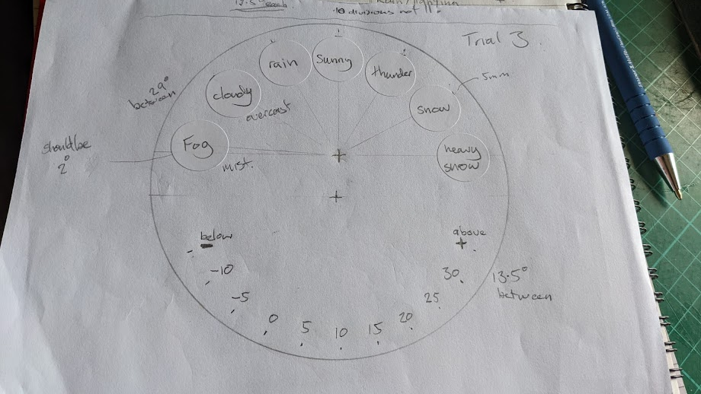
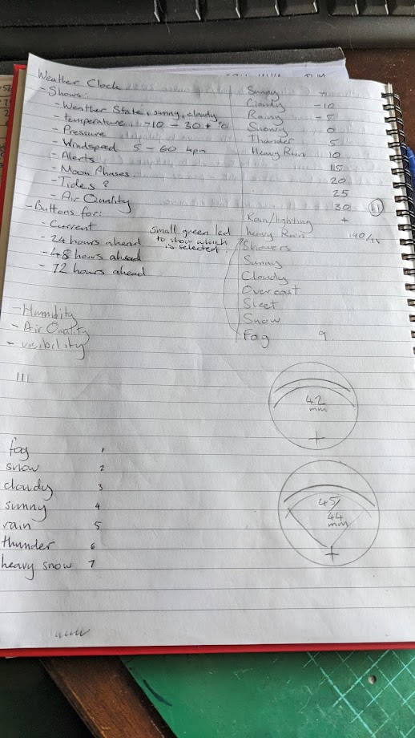
I prepared some fantastic design documents…

Slide 10
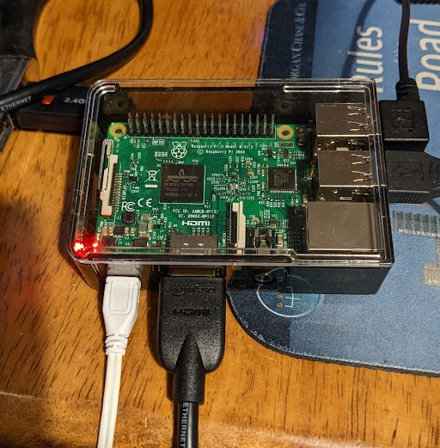
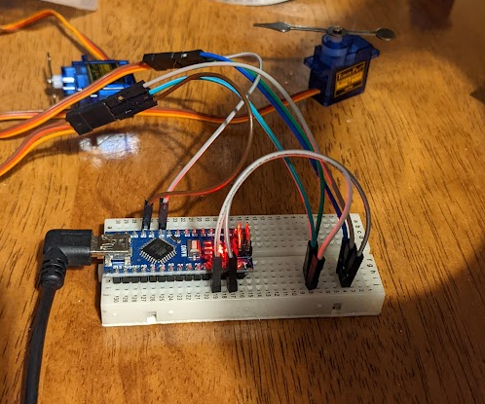
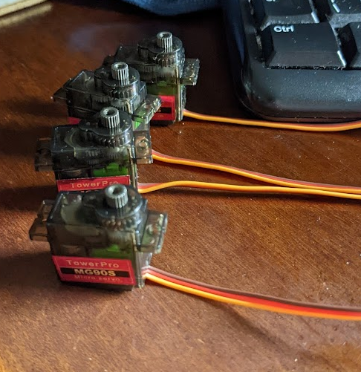
I gathered the electronics…

Slide 11
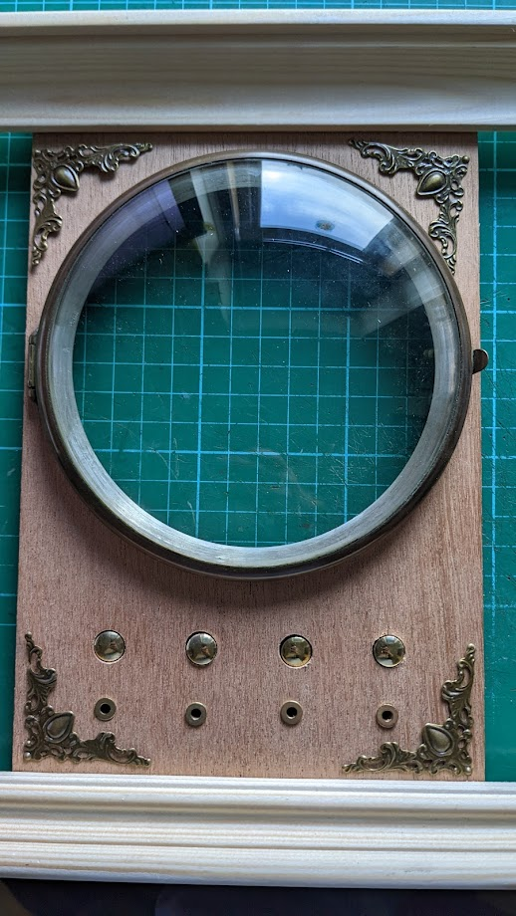
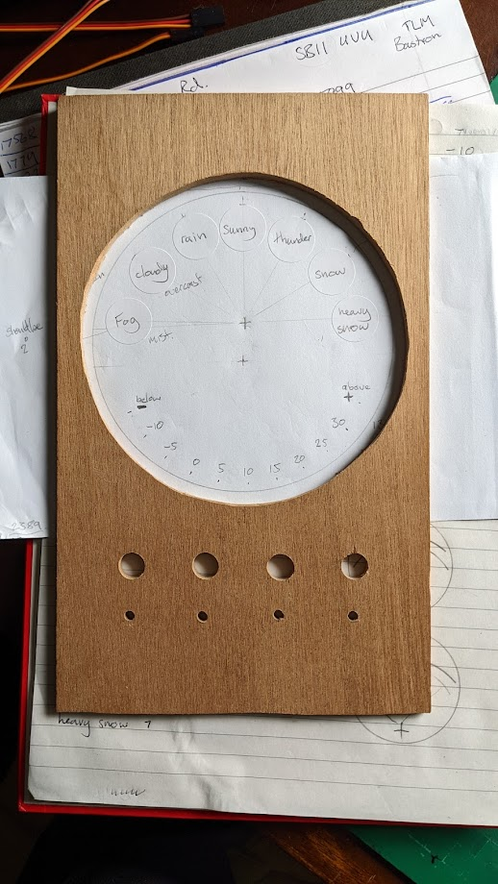
Eventually started building the clock
I had an idea of what I wanted, so I mocked it up with the bits and pieces that I had.
I had now cut the front face and bought from eBay an old clock facia to put my planned face behind
So this was the content of the clock face as well, but it is going to look much better than this

Slide 12
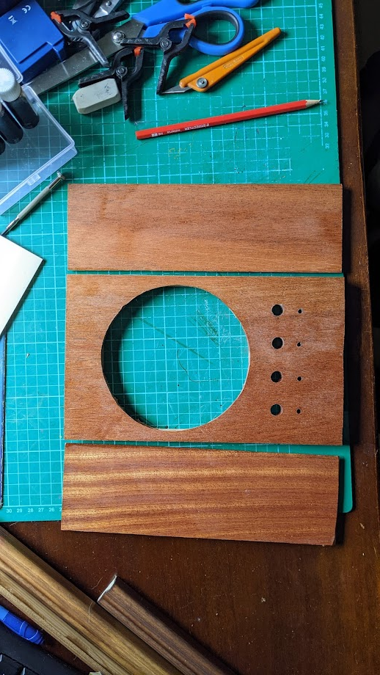
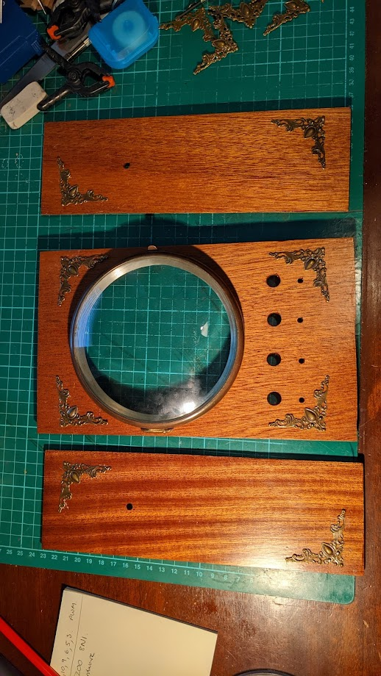
A couple of in build pictures

